Slide 1
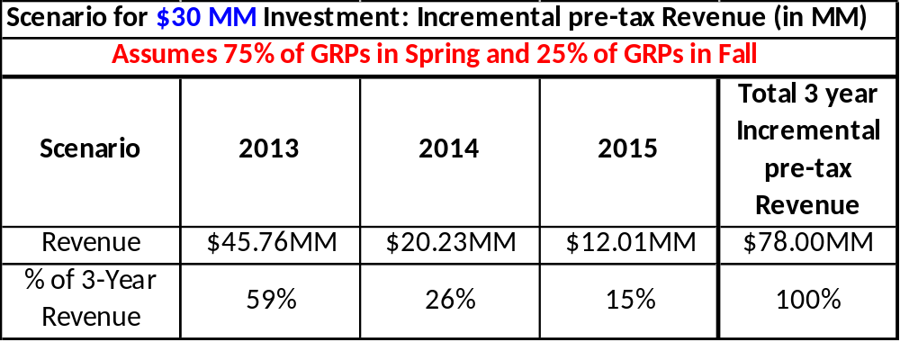
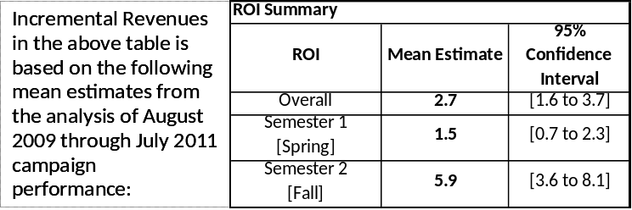
Incremental NPV by Year for 2013 TV Investment Scenario
The following table spreads expected incremental revenue due to Nasonex TV in 2013 across 2013, 2014 and 2015 calendar years. This is based on a $30MM investment, 75% for Spring GRPs and 25% for Fall GRPs.
Notes:
\\wpushh01\dinfopln\PRA\DTC\Nasonex\2011_Analysis\Presentation\RevenueYearlyDistribution_V2.xls

